Slide 1

ALAN TURING
By Yoshita Yadav

Slide 2
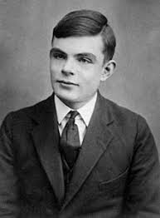
ABOUT ALAN TURING
Alan Turing was born on June 23, 1912 in Maida
Vale, London
He displayed signs of high intelligence from a young age
Turing attended Princeton University from 1936-1938
After earning his Ph.D., he returned to Cambridge and took a job at a British code-breaking organization
He sadly died on 7 June 1954 (aged 41)

Slide 3
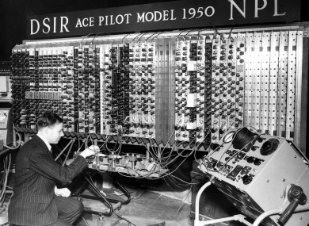
WHAT DID HE ACHIEVE?
Alan was a British pioneering and computer scientist
Alan Turing was able to break Nazi Enigma code during WWII, giving the Allies the edge that they needed to win the war in Europe
He introduced artificial intelligence.

Slide 4
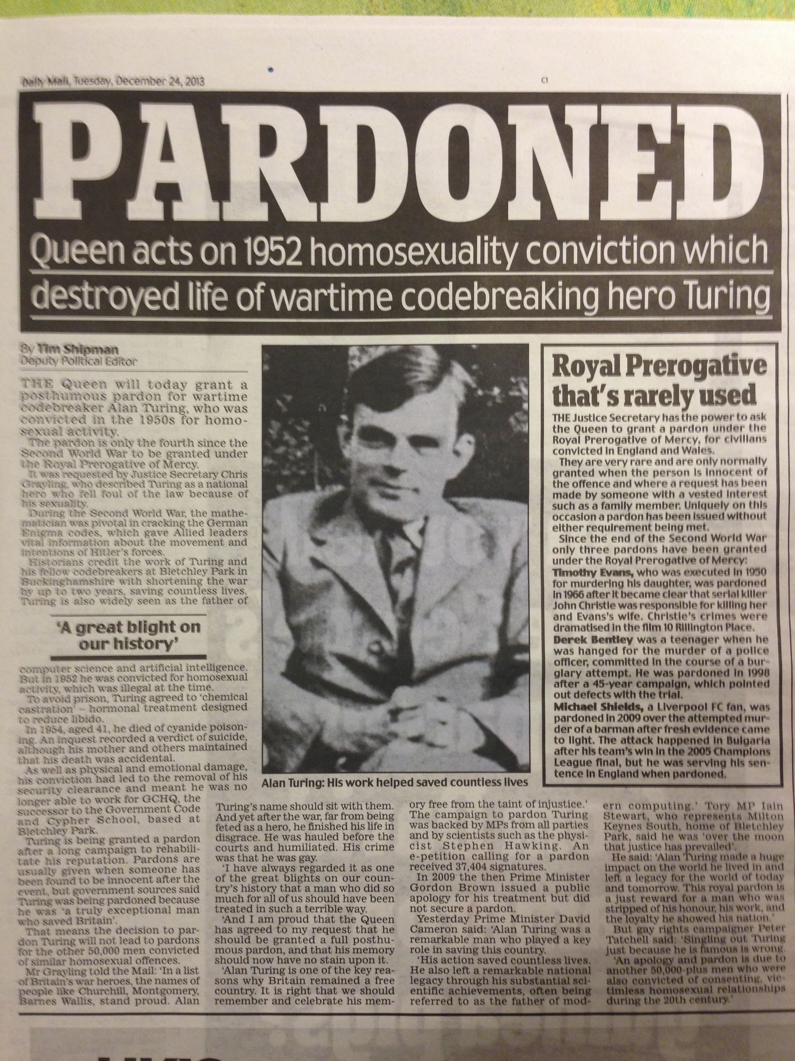
FACTS ABOUT ALAN TURING
Alan Turing addressed the issue of Artificial Intelligence in a 1950 paper, where he proposed an experiment known as the "Turing Test"
He took his own life in 1954, two years after being outed as gay. Homosexuality was seen as a crime in Great Britain at the time, and Turing was convicted of “indecency.”
He died from eating an apple laced with cyanide. He was only 41 years old.
At the time of his death, the public had no idea what he had contributed to the war effort. Sixty years later, Queen Elizabeth II officially pardoned Turing.

Slide 5
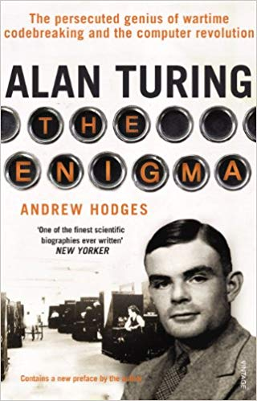
FACTS ABOUT ALAN TURING
Andrew Hodges, a mathematician at the Mathematical Institute at Oxford University, wrote the biography “Alan Turing: The Enigma”, which inspired the film “Imitation Game”.

Slide 6

MOVIE ABOUT HIM
Alan Turing has a movie about him named “ The Imitation Game”

